Slide 1
F
I
R
S
T
C
O
R
N
A
N
I
T
H
I
S
6.12-7.7
A free CD of this message will be available following the service
It will also be available for podcast later this week at calvaryokc.com

Slide 2
All “real men” answer “C” to all of these questions.
A. Present it to the President of the United States
B. Present it to the Secretary General of the United Nations
c. take it apart
O
A
N
S
6.12-7.7
I
I
F
I
R
S
T
C
R
N
T
H

Slide 3
All “real men” answer “C” to all of these questions.
A. Innocence
B. Idealism
c. Cherry bombs
O
A
N
S
6.12-7.7
I
I
F
I
R
S
T
C
R
N
T
H

Slide 4
All “real men” answer “C” to all of these questions.
A. a cat
B. a dog
c. a dog that eats cats
O
A
N
S
6.12-7.7
I
I
F
I
R
S
T
C
R
N
T
H

Slide 5
All “real men” answer “C” to all of these questions.
A. you don't want to rush it
B. You don’t want to Give false hope
c. called a draw play on third and seventeen
O
A
N
S
6.12-7.7
I
I
F
I
R
S
T
C
R
N
T
H

Slide 6
All “real men” answer “C” to all of these questions.
A. democracy
B. laser surgery
c. the remote control
O
A
N
S
6.12-7.7
I
I
F
I
R
S
T
C
R
N
T
H

Slide 7
All “real men” answer “C” to all of these questions.
A. “Do they need to eat or something?”
B. “They're in school already?”
c. “There are three of them?”
O
A
N
S
6.12-7.7
I
I
F
I
R
S
T
C
R
N
T
H

Slide 8
Boys will give “love” in order to get sex …
girls will give sex in order to get “love”
O
A
N
S
6.12-7.7
I
I
F
I
R
S
T
C
R
N
T
H

Slide 9
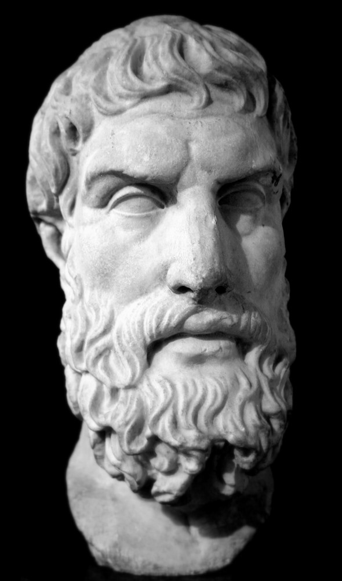
Epicureanism - a philosophical belief system that taught fulfillment through to catering to the bodily (physical) pleasures
Epicurus
O
A
N
S
6.12-7.7
I
I
F
I
R
S
T
C
R
N
T
H

Slide 10
Indulgence in unlawful things has slain its 1,000s
Indulgence in lawful things has slain its 10s of 1,000s
O
A
N
S
6.12-7.7
I
I
F
I
R
S
T
C
R
N
T
H

Slide 11
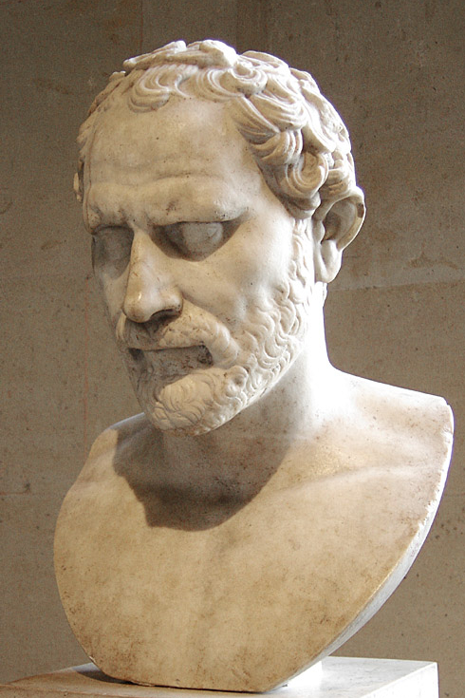
Demosthenes - “Now
we have courtesans
for the sake of
pleasure, but
concubines for the
sake of daily cohabitation, and
wives for the
purpose of having
Demosthenes
O
A
N
S
6.12-7.7
I
I
F
I
R
S
T
C
R
N
T
H

Slide 12
children legiti-
mately, and of
having a faithful guardian of all
our household
affairs.”
Demosthenes
O
A
N
S
6.12-7.7
I
I
F
I
R
S
T
C
R
N
T
H

Slide 13
Prov. 9.17-18 - ¹⁷ “Stolen water is sweet,
And bread eaten in secret is pleasant.”
¹⁸ But he does not know that the dead are there,
That her guests are in the depths of hell.
O
A
N
S
6.12-7.7
I
I
F
I
R
S
T
C
R
N
T
H

Slide 14
Heb.12.14-16 - ¹⁴ Pursue peace with all people, and holiness, without which no one will see the Lord: ¹⁵ looking carefully lest anyone fall short of the grace of God; lest any root of bitterness springing up cause
O
A
N
S
6.12-7.7
I
I
F
I
R
S
T
C
R
N
T
H

Slide 15
trouble, and by this many become defiled; ¹⁶ lest there be any fornicator or profane person like Esau, who for one morsel of food sold his birthright.
O
A
N
S
6.12-7.7
I
I
F
I
R
S
T
C
R
N
T
H

Slide 16
Billy Graham – “Church-goers are like coals in a fire. When they cling together, they keep the flame aglow; when they separate, they die out.”
O
A
N
S
6.12-7.7
I
I
F
I
R
S
T
C
R
N
T
H

Slide 17
DIVORCE
RE-MARRIAGE
BEING SINGLE
VIRGINS
SEX
WIDOWS
$200
$200
$200
$200
$200
$200
$400
$400
$400
$400
$400
$400
GOD HATES IT
$600
$600
$600
$600
$600
$600
$800
$800
$800
$800
$800
$800
$1000
$1000
$1000
$1000
$1000
$1000
O
A
N
S
6.12-7.7
I
I
F
I
R
S
T
C
R
N
T
H

Slide 18
Ephesians 5:22–33 Marriage—Christ and the Church
²² Wives, submit to your own husbands, as to the Lord. ²³ For the husband is head of the wife, as also Christ is head of the church; and He is the Savior of the body. ²⁴ Therefore, just as the church is subject to Christ, so let the wives be to their own husbands in everything.
²⁵ Husbands, love your wives, just as Christ also loved the church and gave Himself for her, ²⁶ that He might sanctify and cleanse her with the washing of water by the word, ²⁷ that He might present her to Himself a glorious church, not having spot or
wrinkle or any such thing, but that she should be holy and without blemish. ²⁸ So husbands ought to love their own wives as their own bodies; he who loves his wife loves himself. ²⁹ For no one ever hated his own flesh, but nourishes and cherishes it, just as the Lord does the church. ³⁰ For we are members of His body, of His flesh and of His bones. ³¹ “For this reason a man shall leave his father and mother and be joined to his wife, and the two shall become one flesh.” ³² This is a great mystery, but I speak concerning Christ and the church. ³³ Nevertheless let each one of you in particular so love his own wife as himself, and let the wife see that she respects her husband.
The Marriage Manual
- God
O
A
N
S
6.12-7.7
I
I
F
I
R
S
T
C
R
N
T
H

Slide 19
Epicureans (6:12-20) - a philosophical belief system that taught fulfillment through to catering to the bodily (physical) pleasures
Stoicism (7:1-7) - a philosophical belief system that taught fulfillment through a denial of bodily (physical) pleasures
O
A
N
S
6.12-7.7
I
I
F
I
R
S
T
C
R
N
T
H

Slide 20
Render - apodidomi – to pay a debt
Matt. 22.21b -
Render therefore to Caesar the things that are Caesar's, and to God the things that are God's.
Rom. 13:7 - Render … taxes to whom taxes are due,
O
A
N
S
6.12-7.7
I
I
F
I
R
S
T
C
R
N
T
H

Slide 21
Deprive - KJV, defraud
1 Cor. 6:7a - Why do you not rather let yourselves be cheated?
O
A
N
S
6.12-7.7
I
I
F
I
R
S
T
C
R
N
T
H

Slide 22
Lack of self-control -
KJV, incontinency
Matt. 16:25 - For whoever desires to save his life will lose it, but whoever loses his life for My sake will find it,
O
A
N
S
6.12-7.7
I
I
F
I
R
S
T
C
R
N
T
H

Slide 23
Martin Luther – “Let the wife make her husband glad to come home and let him make her sorry to see him leave.”
O
A
N
S
6.12-7.7
I
I
F
I
R
S
T
C
R
N
T
H

Slide 24
Gift – charisma – grace gift or spiritual gift
O
A
N
S
6.12-7.7
I
I
F
I
R
S
T
C
R
N
T
H

